Slide 1
C.V. Raman Global University Bhubaneswar,Odisha
ds_lab_case_study.c
bank_data.txt
Department Of Computer Science
#include<stdio.h>
int main()
{
printf(“Group: 6B,Team: 14 \n”);
printf(“Topic: Bank Management system”);
Dr. Adyasha Rath & Mr. Jyoti Ranjan Swain

Slide 2
Team Members
Samar Kumar Singh | 2201020575
Soumya Ranjan Biswal | 2201020576
Ankit Kumar | 2201020577
Sanjib Harichandan | 2201020578
Warisha Mazhar | 2201020579
Ramit Kumar Sahoo | 2201020580
Data Structure

Slide 3
Introduction
The Bank Management System is a software application developed in the C programming language to facilitate the management of bank accounts. It provides functionalities such as creating new accounts, updating existing account information, conducting transactions (deposits and withdrawals), checking account details, removing accounts, and viewing a list of customer accounts.
Data Structure

Slide 4
File Handling
In C, a binary file is a file that contains data in a format that is not human-readable.
Here are some characteristics and key points about binary files in C:
No Text Formatting: Unlike text files, which store data in a human-readable format (like characters and strings), binary files store data in its raw, binary form.
Read and Write Operations: Binary files are typically opened in binary mode using functions like fopen, fread, fwrite, fclose, etc. The binary mode ("rb" for reading and "wb" for writing) ensures that data is read or written as raw bytes without any character encoding.
Data Structure

Slide 5
Header File’s & Structure Defining
case_study.c
bank_data.txt
#include <stdio.h>
#include <stdlib.h>
#include <string.h>
#define FILE_NAME "bank_data.txt"
typedef struct
{
char name[50];
char email[50];
char phone[15];
char account_type[10];
char address[100];
char dob[11];
char aadhar_no[13];
char pan_no[11];
int account_no;
float balance;
} Account;
The code includes three standard libraries: `stdio.h` for input/output, `stdlib.h` for memory allocation, and `string.h` for string manipulation. It defines `FILE_NAME` as "bank_data.txt", likely for specifying a file to store bank account data.
Additionally, the code defines a structure called `Account`, which encompasses various fields (e.g., name, email, phone) to represent bank account holder information. This structure covers personal details, account specifics, and unique identifiers like Aadhar and PAN numbers.
Data Structure

Slide 6
Account Number Generator
case_study.c
bank_data.txt
int accountNumber(){
FILE *fp;
fp = fopen(FILE_NAME, "rb");
if (fp == NULL){
printf("\n\n\t\t\tError in opening file!");
return 0;
}
int accNo = 0;
Account account;
while (fread(&account, sizeof(Account), 1, fp)){
accNo = account.account_no;
} if (accNo == 0){
return 1;
}
else{
accNo++;
return accNo;
}
}
It first tries to open a file named "bank_data.txt" in binary read mode ("rb").
If the file opening operation fails (due to some error or if the file doesn't exist), it displays an error message and returns 0 to indicate an error.
If the file is successfully opened, it initializes accNo (account number) to 0.
It then reads each existing account's data from the file and updates accNo with the account number of the last account read.
If no accounts are found (meaning accNo remains 0), it returns 1 as the first account number.
If there are existing accounts, it increments accNo by one and returns it, providing a unique account number for a new account.
Data Structure

Slide 7
void create_account()
case_study.c
bank_data.txt
The function `create_account` prompts the user to input details for a new account. It assigns a unique account number, sets initial balance to zero, and writes the account information to a file. If there's an error opening the file, it displays an error message. Finally, it confirms successful account creation with the assigned account number.
void update_account()
The "update_account" function prompts the user to input an account number. It then attempts to open a file for reading and writing. If successful, it searches for the specified account. Upon finding it, the function offers a menu to update various account details. Depending on the choice, it prompts for new information and applies the update. Finally, it saves the changes to the file and notifies the user of the successful update. If the account is not found, it displays a message accordingly.
Data Structure

Slide 8
void transaction()
case_study.c
bank_data.txt
The "transaction" function facilitates account transactions. It prompts for an account number and choice (deposit or withdraw). It then reads the account file, locates the specified account, and executes the chosen transaction. If successful, it updates the balance, saves it to the file, and displays the new balance. If the account is not found or there's an error, it provides appropriate feedback.
void check_account_details()
The function "check_account_details" prompts the user to enter an account number. It then searches for that account number in the file. If found, it prints out the associated account details, including name, email, phone, account type, address, date of birth, Aadhar number, PAN number, account number, and current balance. If the account is not found, it displays an error message. Finally, it closes the file.
Data Structure

Slide 9
void remove_account()
case_study.c
bank_data.txt
The function "remove_account" prompts the user to input an account number for removal. It then opens the bank data file and a temporary file. It iterates through the accounts, copying all except the specified one to the temporary file. Afterward, it closes both files, replaces the original with the updated version, and notifies the user of successful account removal.
void view_customer_list()
The function "view_customer_list" opens the file for reading, checks for errors, then iterates through each account record. It prints a formatted list of customer names, account numbers, and balances. Finally, it closes the file.
Data Structure

Slide 10
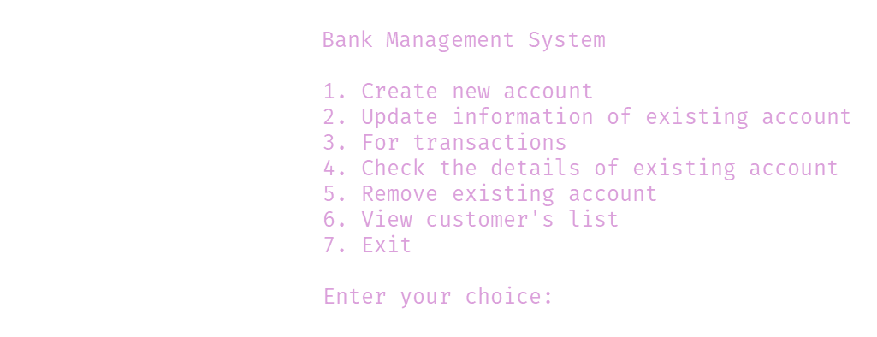
Main Function()
case_study.c
bank_data.txt
This code defines the main function of a Bank Management System. It presents a menu to the user with options like creating accounts, updating information, conducting transactions, checking details, removing accounts, viewing customer list, and exiting. The program continues to prompt the user for choices in a loop until they choose to exit.
Data Structure

Slide 11
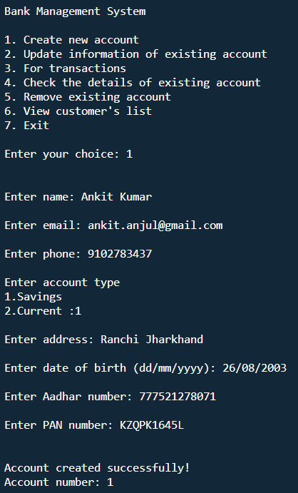
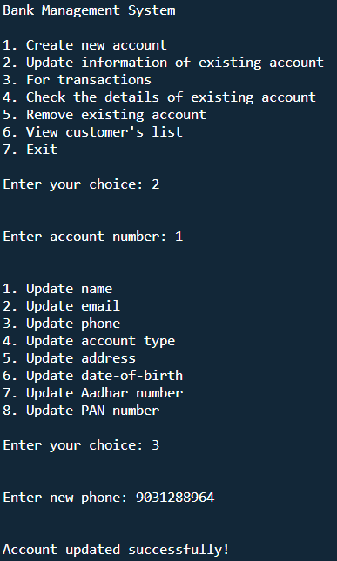
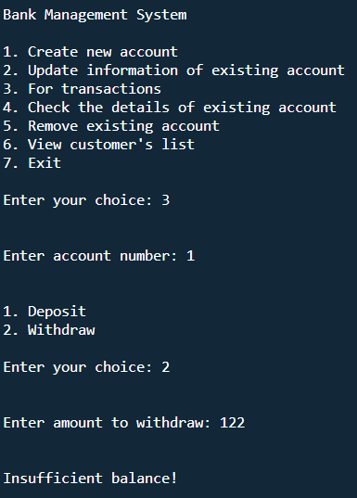
case_study.c
bank_data.txt
OUTPUT!!
Data Structure

Slide 12
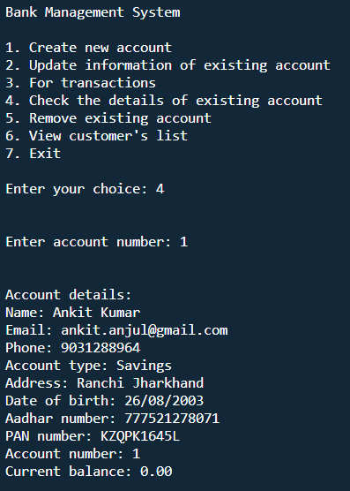
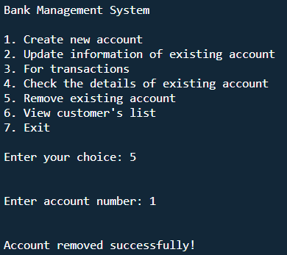
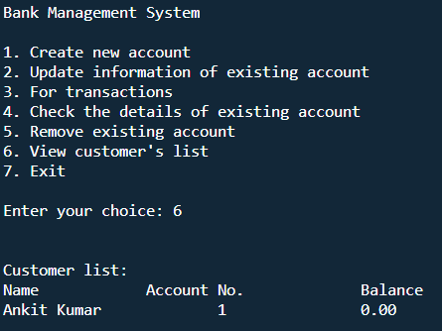
case_study.c
bank_data.txt
OUTPUT!!
Data Structure

Slide 13
case_study.c
bank_data.txt
Printf(“Thank You!!”);
}
Data Structure

